Slide 1
Sampling, and edges CS B657 Spring 2017

Slide 2
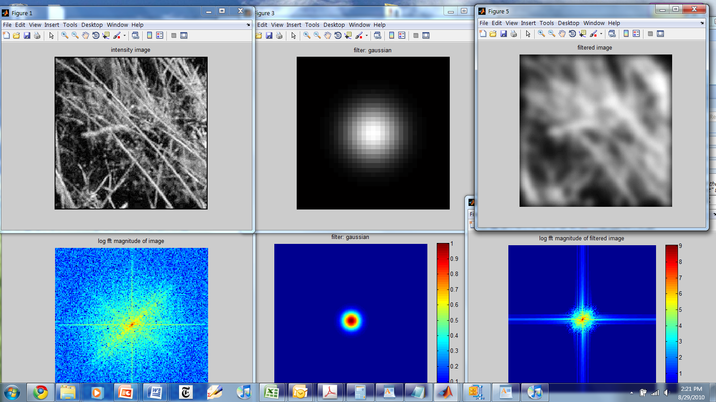
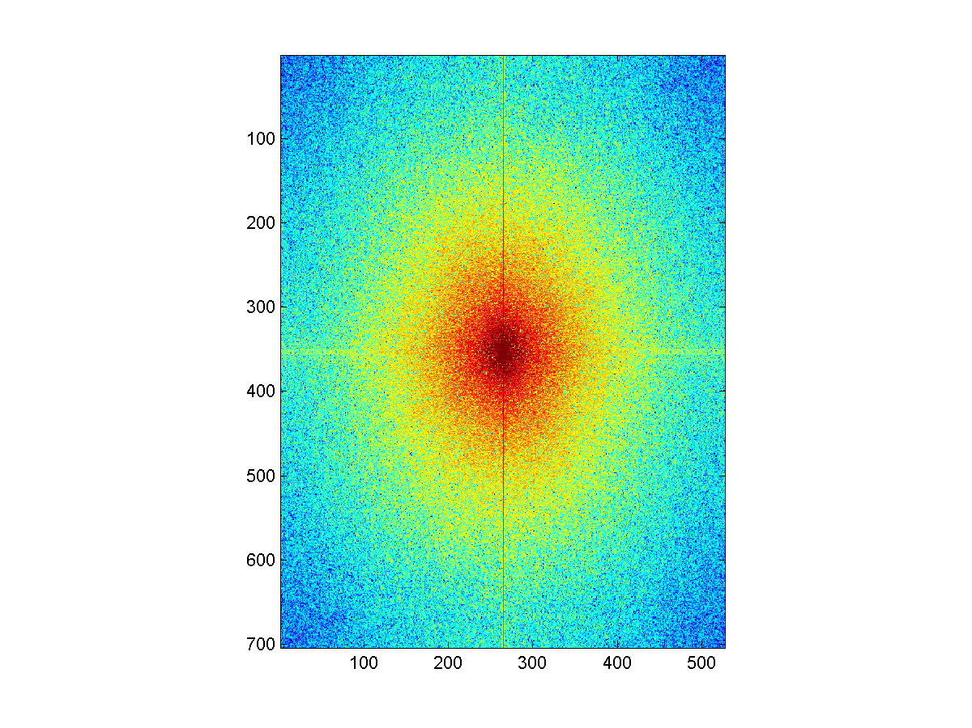
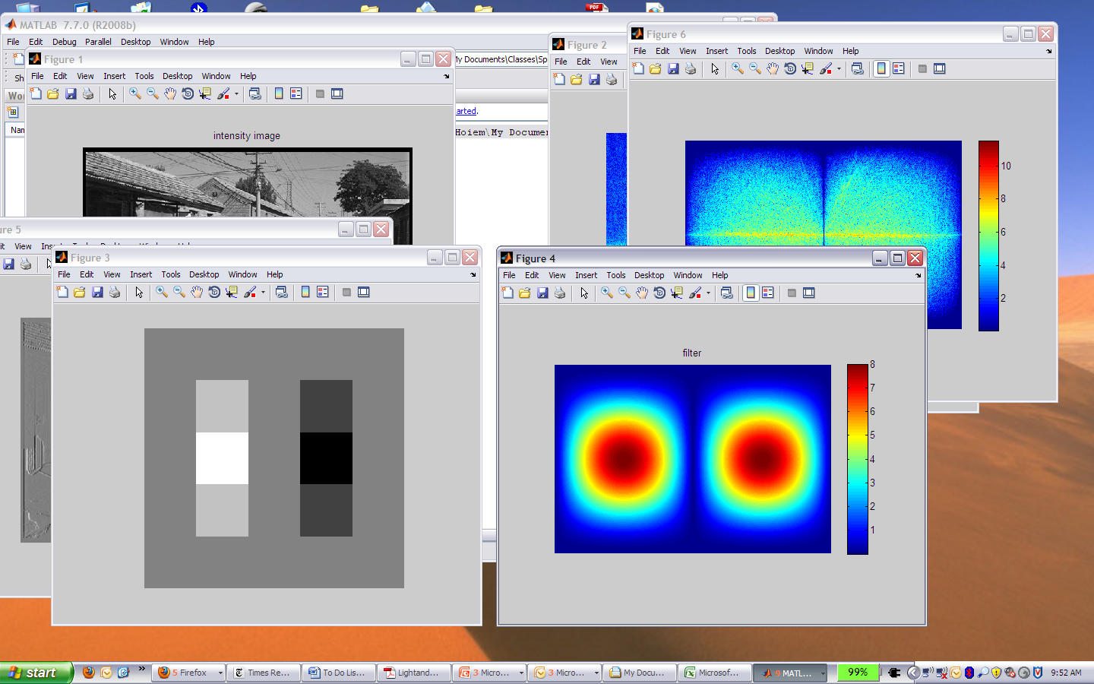
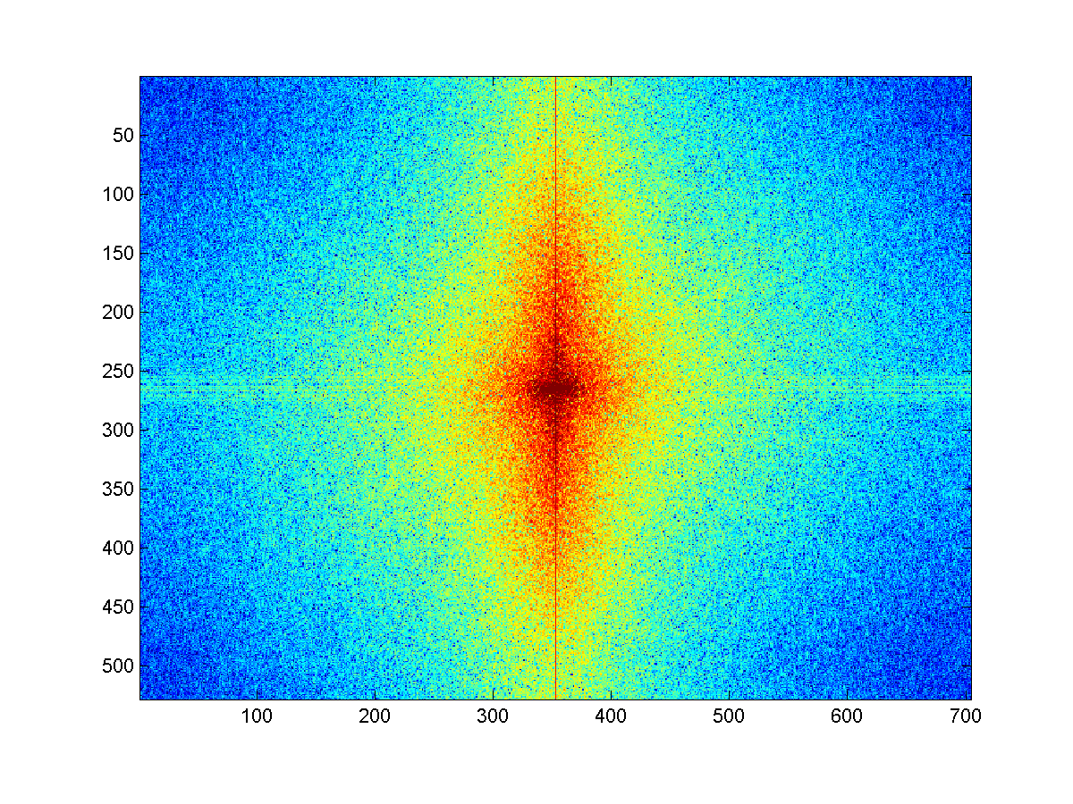
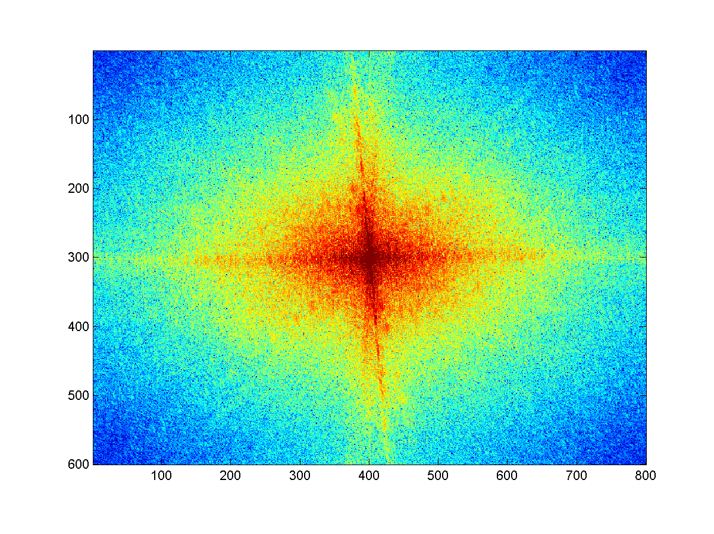
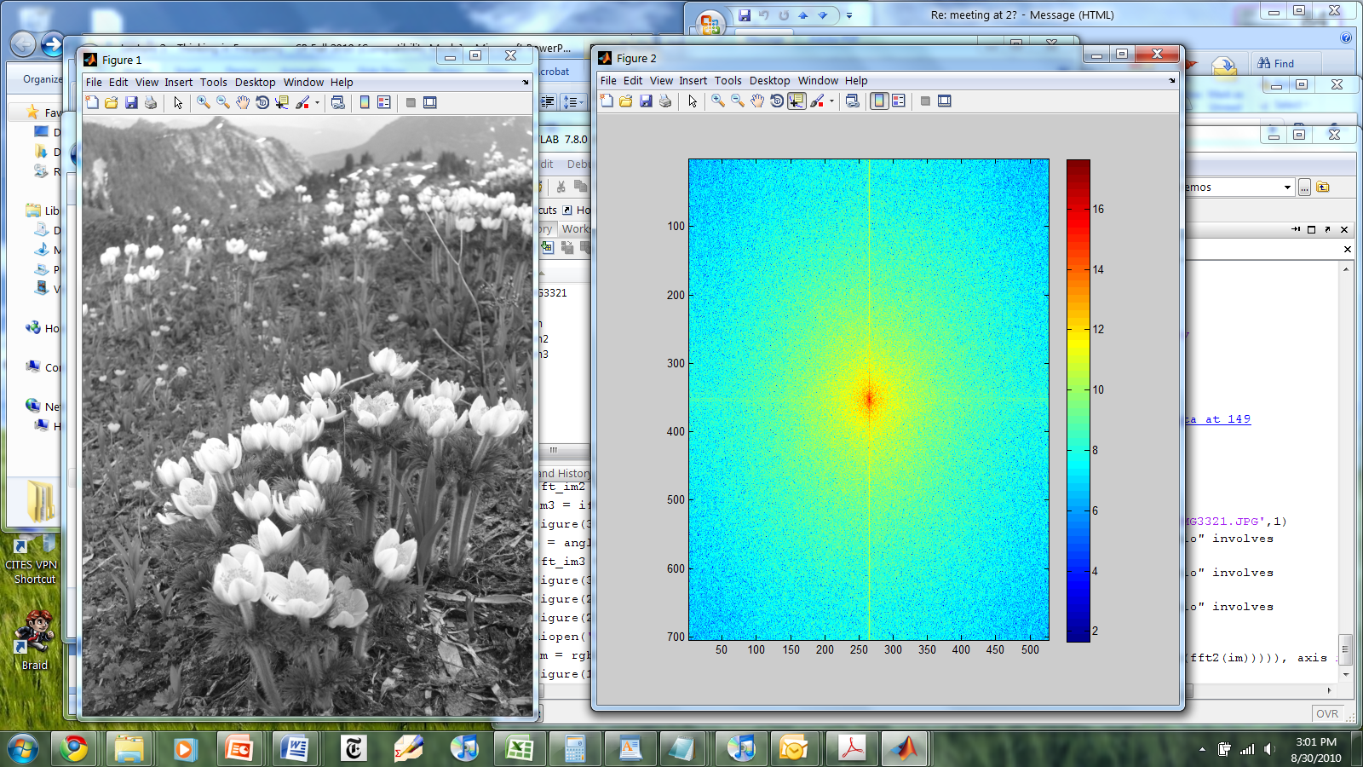
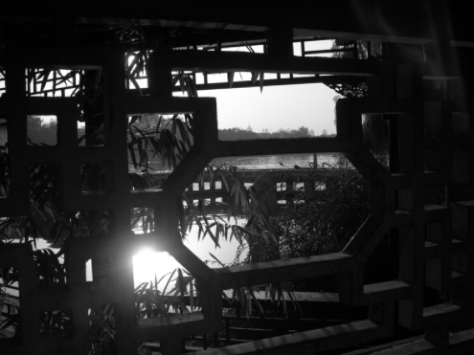
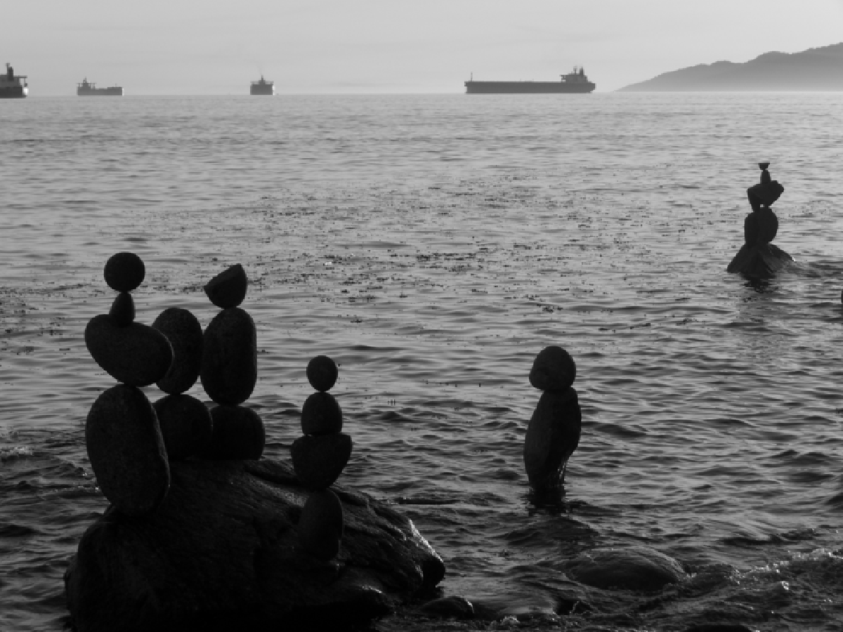


Review question
Match the spatial domain image to the Fourier magnitude image
1
2
3
4
5
B
A
C
E
D
Slide credit: Hoiem

Slide 3
Fourier Transform
Fourier transform stores the magnitude and phase at each frequency
Magnitude encodes how much signal there is at a particular frequency
Phase encodes spatial information (indirectly)
For mathematical convenience, this is often notated in terms of real and complex numbers
Amplitude:
Phase:

Slide 4
The Convolution Theorem
The Fourier transform of the convolution of two functions is the product of their Fourier transforms
The inverse Fourier transform of the product of two Fourier transforms is the convolution of the two inverse Fourier transforms
Convolution in spatial domain is equivalent to multiplication in frequency domain!
What’s the computational advantage of this?

Slide 5
Properties of Fourier Transforms
Linearity
Fourier transform of a real signal is symmetric about the origin
The energy of the signal is the same as the energy of its Fourier transform
See Szeliski Book (3.4)

Slide 6
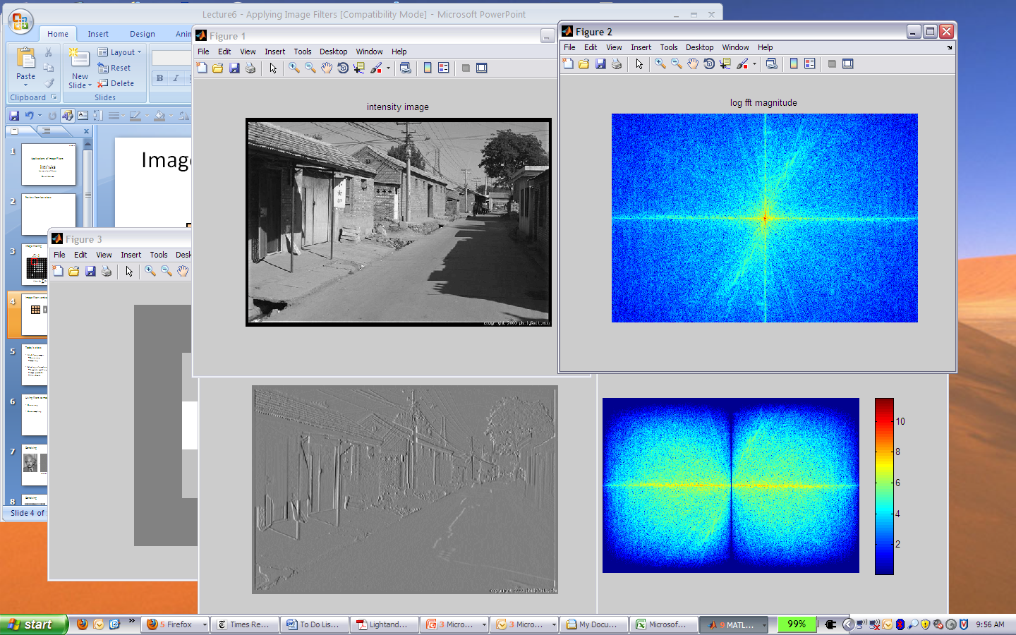
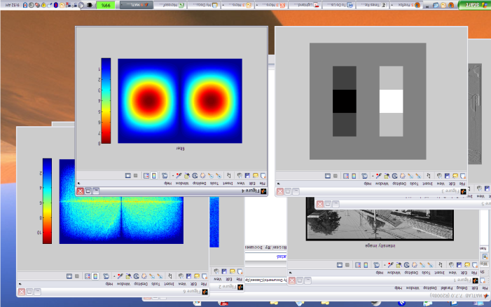
Filtering in spatial domain
1
0
-1
2
0
-2
1
0
-1
*
=
Slide credit: Hoiem

Slide 7
Filtering in frequency domain
FFT
FFT
=
Inverse FFT
Slide: Hoiem

Slide 8
Gaussian
Slide credit: Hoiem

Slide 9
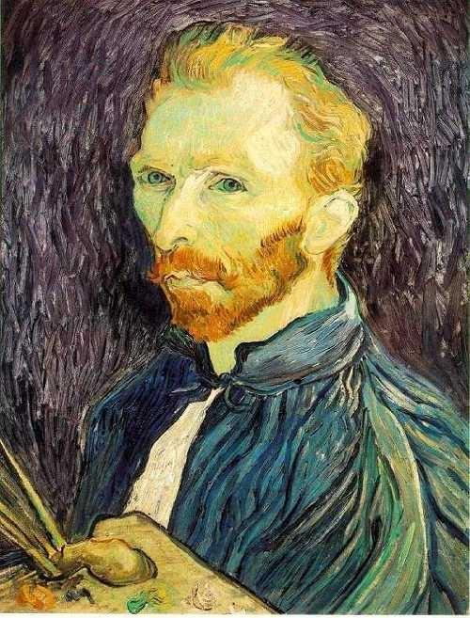
Image Scaling
This image is too big to fit on the screen. How can we generate a half-sized version?
Source: S. Seitz

Slide 10
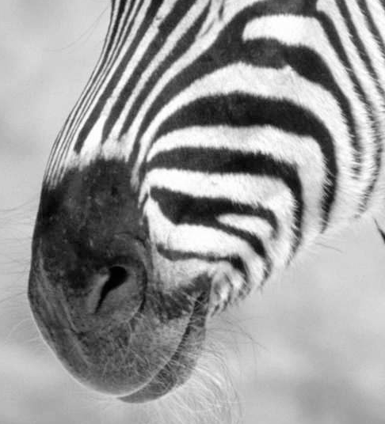
Subsampling by a factor of 2
Throw away every other row and column to create a 1/2 size image
Slide credit: Hoiem

Slide 11

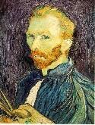

Image sub-sampling
1/8
1/4
Throw away every other row and column to create a 1/2 size image
- called image sub-sampling
Source: S. Seitz

Slide 12
Image sub-sampling
1/2
1/4 (2x zoom)
1/8 (4x zoom)
Source: S. Seitz

Slide 13
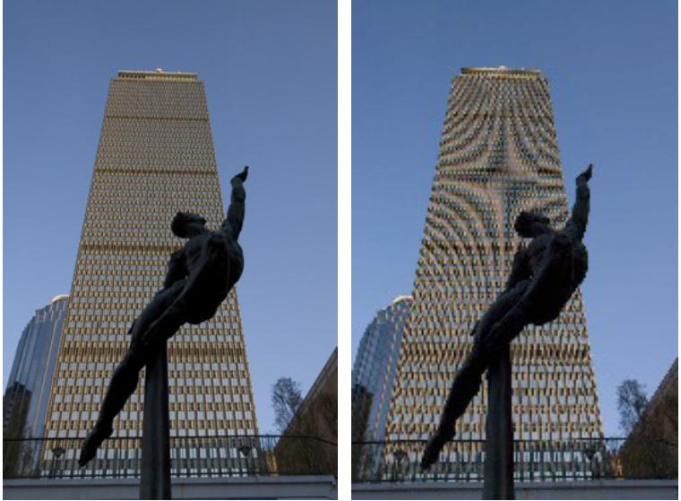
Image sub-sampling
Source: F. Durand

Slide 14
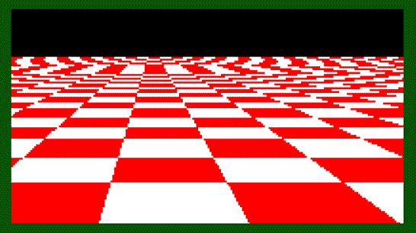
Even worse for synthetic images
Source: L. Zhang

Slide 15
Aliasing in video
https://www.youtube.com/watch?v=jrURKUg4I-I

Slide 16
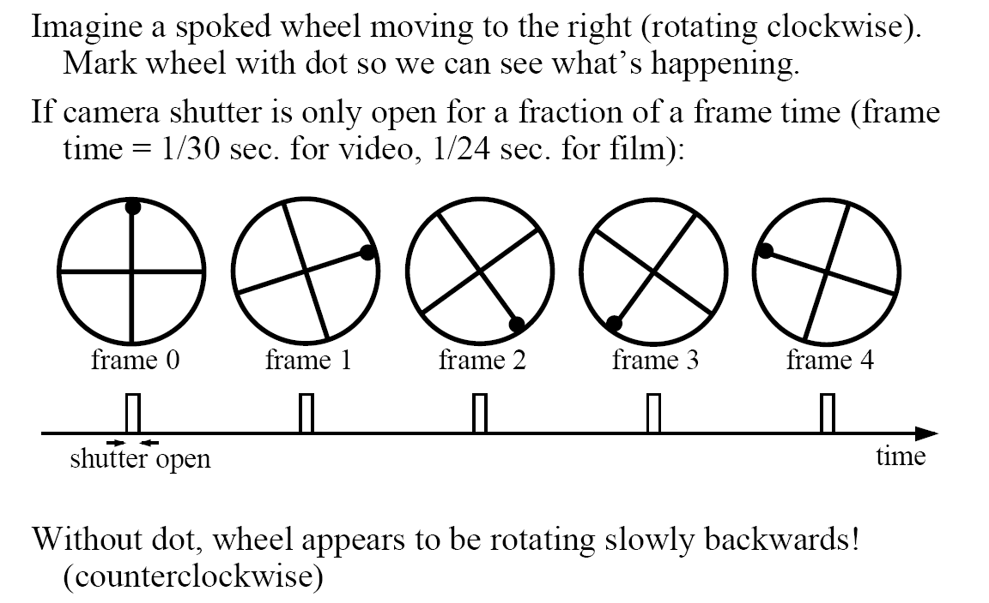
Wagon wheel effect
Slide by Steve Seitz

Slide 17
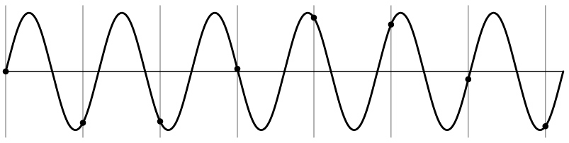
Aliasing problem
1D example (sinewave):
Source: S. Marschner

Slide 18
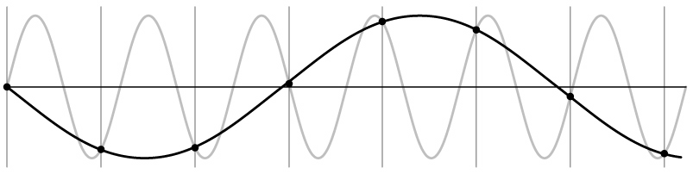
Aliasing problem
1D example (sinewave):
Source: S. Marschner

Slide 19
Nyquist-Shannon Sampling Theorem
When sampling a signal at discrete intervals, the sampling frequency must be ≥ 2 × f_{max}
f_{max} = max frequency of the input signal
This will allows to reconstruct the original perfectly from the sampled version
v
v
v
good
bad
Slide credit: Hoiem

Slide 20
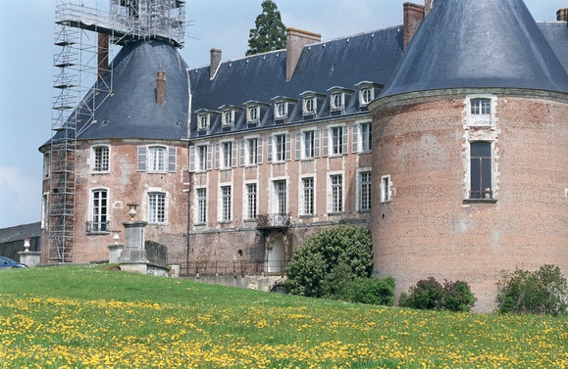
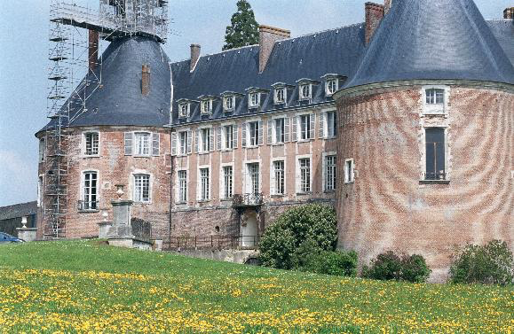
So how do we prevent this?
http://www.svi.nl/AntiAliasing

Slide 21
Anti-aliasing
Solutions:
Sample more often
Get rid of all frequencies that are greater than half the new sampling frequency
Will lose information
But it's better than aliasing
Apply a smoothing filter

Slide 22



Gaussian pre-filtering
G 1/8
G 1/4
Gaussian 1/2
Solution: filter the image, then subsample
Source: S. Seitz

Slide 23
Subsampling with Gaussian pre-filtering
Gaussian 1/2
G 1/4
G 1/8
Solution: filter the image, then subsample
Source: S. Seitz

Slide 24
Compare with...
1/2
1/4 (2x zoom)
1/8 (4x zoom)
Source: S. Seitz

Slide 25
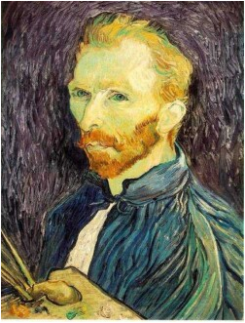







Gaussian pre-filtering
Solution: filter the image, then subsample
F₀
F₁
F₂
…
blur
subsample
blur
subsample
F₀ H
F₁ H
*
*

Slide 26


Why does a lower resolution image still make sense to us? What do we lose?
Image: http://www.flickr.com/photos/igorms/136916757/

Slide 27
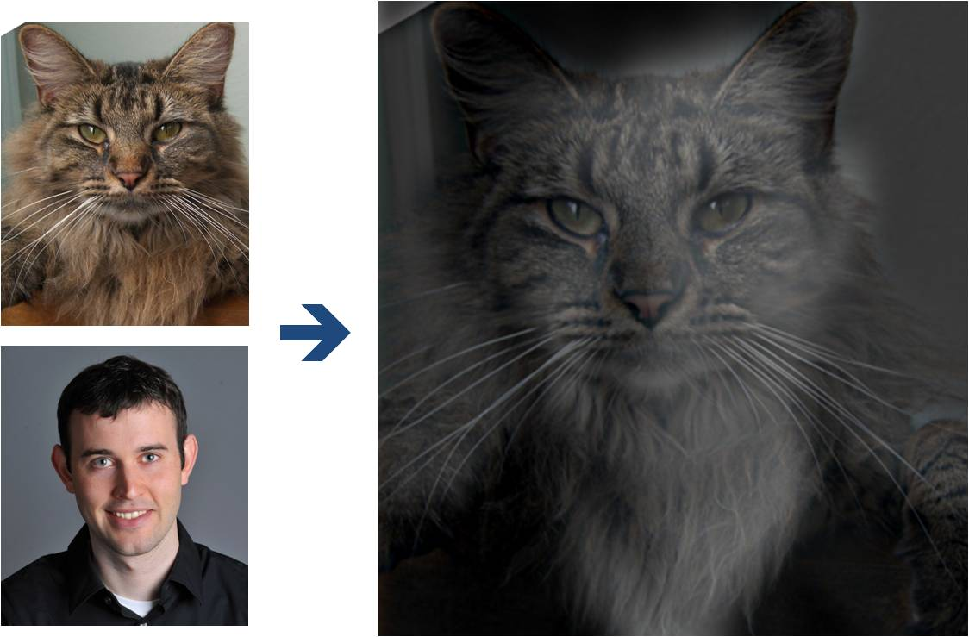
Why do we get different, distance-dependent interpretations of hybrid images?
?
Slide credit: Hoiem

Slide 28
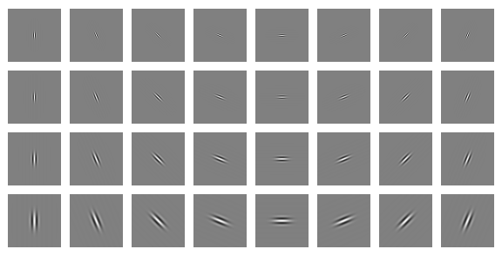
Clues from Human Perception
The early human visual system filters images at different frequencies and orientations
Mid frequencies dominate perception
When we see an image from far away, we are effectively subsampling it
Early Visual Processing: Multi-scale edge and blob filters
Slide credit: Hoiem

Slide 29
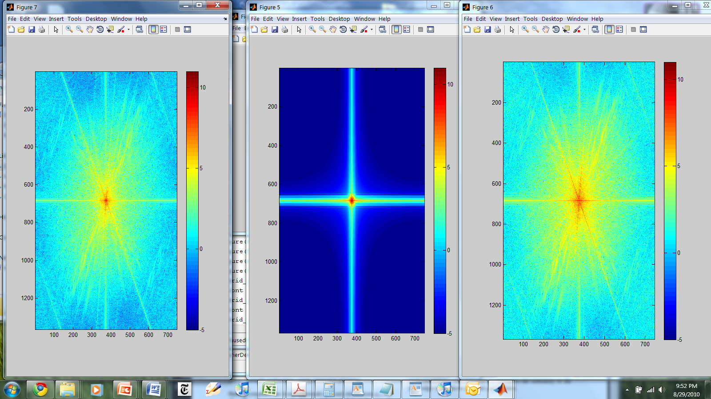
Hybrid Image in FFT
Hybrid Image
Low-passed Image
High-passed Image
Slide credit: Hoiem

Slide 30
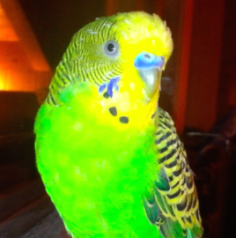



Why does image compression work so well?
143 kB PNG
14 kB JPG
(except when it doesn't?)
150 kB PNG
15 kB JPG

Slide 31
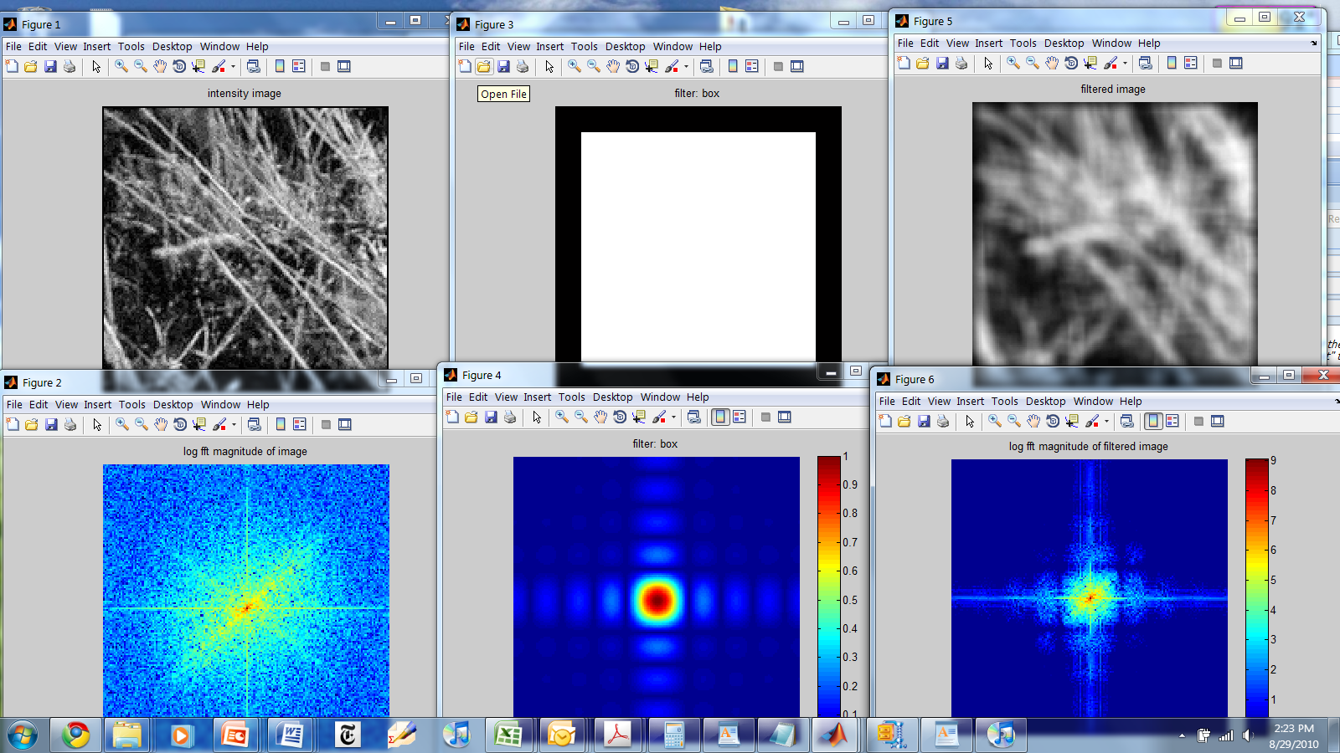
Things to Remember
Sometimes it makes sense to think of images and filtering in the frequency domain
Fourier analysis
Can be faster to filter using FFT for large images (N log N vs. N² for auto-correlation)
Images are mostly smooth
Basis for compression
Remember to low-pass before sampling
Slide credit: Hoiem

Slide 32
Edge detection

Slide 33
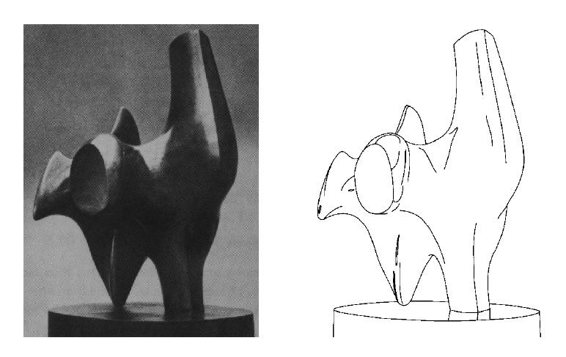
Edge detection
Convert a 2D image into a set of curves
Extracts salient features of the scene
More compact than pixels
TexPoint fonts used in EMF.
Read the TexPoint manual before you delete this box.: AAA

Slide 34
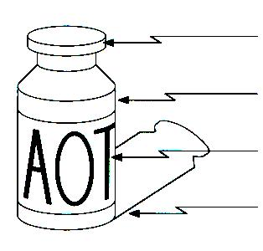
Origin of Edges
surface normal discontinuity
depth discontinuity
surface color discontinuity
illumination discontinuity
Edges are caused by a variety of factors

Slide 35

Characterizing edges
An edge is a place of rapid change in the image intensity function
intensity function (along horizontal scanline)
image
first derivative
edges correspond to extrema of derivative
Source: L. Lazebnik

Slide 36

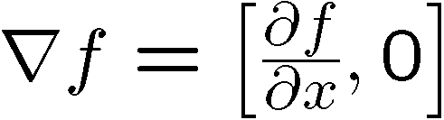
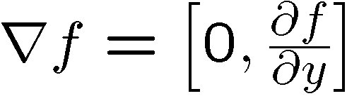
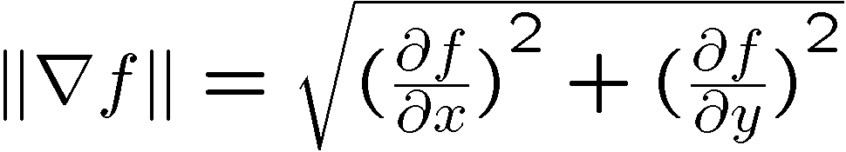
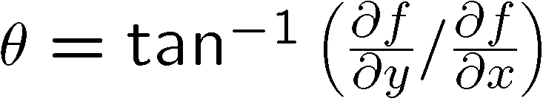
Image gradient
The gradient of an image:
The gradient points in the direction of most rapid increase in intensity
The edge strength is given by the gradient magnitude:
The gradient direction is given by:
how does this relate to the direction of the edge?
Source: Steve Seitz
Notes:
give definition of partial derivative: lim h->0 [f(x+h,y) – f(x,y)]/h

Slide 37
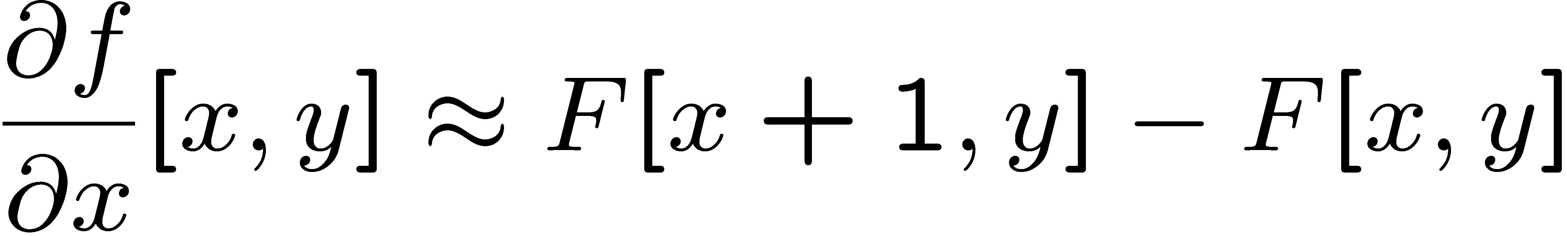
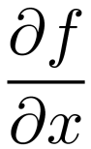
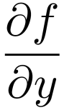
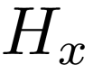
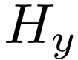
Image derivatives
How can we differentiate a digital image F[x,y]?
Option 1: reconstruct a continuous image, f, then compute the derivative
Option 2: take discrete derivative (finite difference)
How would you implement this as a linear filter?
1 | -1
 | -1
 | 1
:
:
Source: S. Seitz

Slide 38
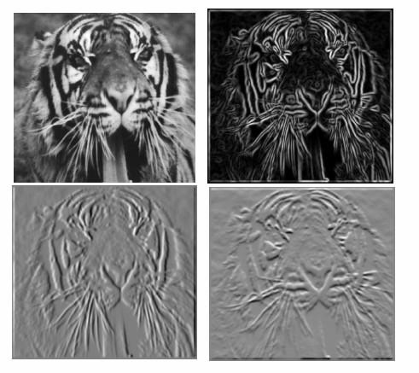
Image gradient
Source: L. Lazebnik

Slide 39

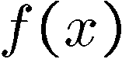
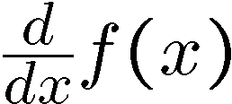
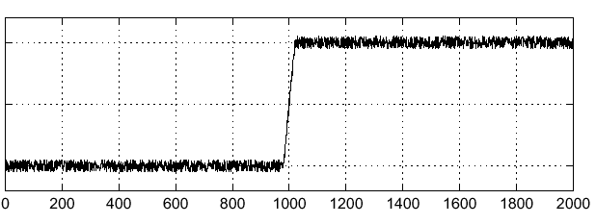
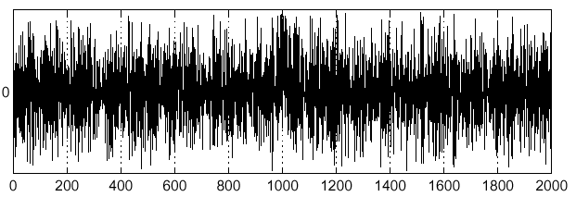
Effects of noise
Noisy input image
Where is the edge?
Source: S. Seitz
Notes:
How to fix?

Slide 40
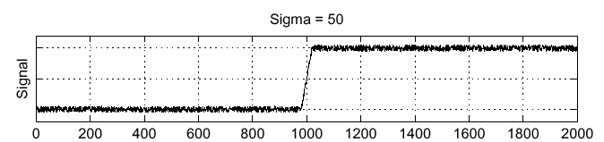
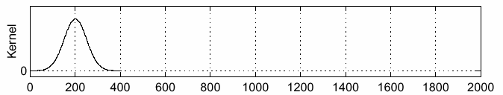
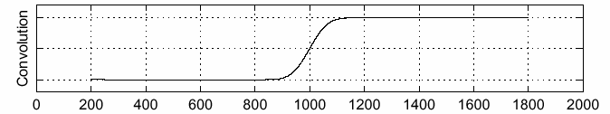
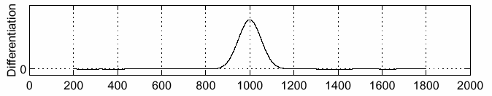
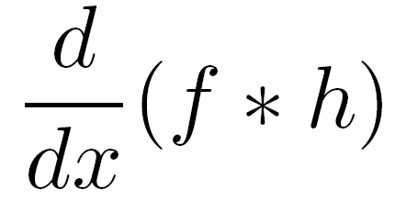
Solution: smooth first
f
h
f * h
To find edges, look for peaks in
Source: S. Seitz

Slide 41
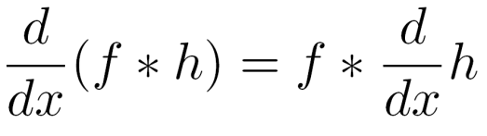
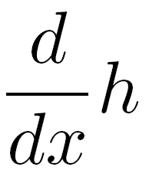
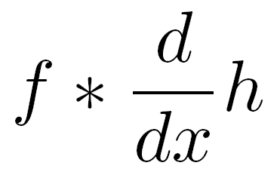

A simpler solution
A useful identity:
This saves us one operation:
f
Source: S. Seitz

Slide 42




2D edge detection filters
derivative of Gaussian (x)
Gaussian
Notes:
How many 2nd derivative filters are there? There are four 2nd partial derivative filters.
In practice, it’s handy to define a single 2nd derivative filter—the Laplacian

Slide 43


Derivative of Gaussian filter
x-direction
y-direction

Slide 44



The Sobel operator
Common approximation of derivative of Gaussian
-1 | 0 | 1
-2 | 0 | 2
-1 | 0 | 1
1 | 2 | 1
0 | 0 | 0
-1 | -2 | -1
Notes:
44
Q: Why might these work better?
A: more stable when there is noise

Slide 45








Sobel operator: example
Source: Wikipedia

Slide 46

Example
original image (Lena)

Slide 47

Finding edges
gradient magnitude

Slide 48


Finding edges
useful edges
disappeared
Multiple detections
thresholding

Slide 49
What makes a good edge detector?
Goals for edge detection
Minimize rate of multiple detection (2 pixels classified as edges that correspond to same image edge)
Minimize probability of false detection
Minimize distance between reported edge and true edge location
Canny (1986) studied these criteria
Showed that derivative of Gaussian is optimal (in 1D)
Developed heuristics for satisfying criteria in 2D

Slide 50

Non-maximum suppression
Check if pixel is local maximum along gradient direction
requires interpolating pixels p and r

Slide 51

Finding edges
thinning
(non-maximum suppression)

Slide 52
Canny Thresholding
Low thresholds create more edges, but at the cost of more spurious edge pixels
Canny proposes a two-level threshold
Edge pixel’s gradient magnitude must be above low threshold, and connected to an edge pixel
Start by keeping (classifying as edges) all candidates above high threshold
Recursively, if pixel above low threshold and adjacent to an edge pixel keep it

Slide 53


Summary: Canny edge detector
Filter image with derivative of Gaussian
Find magnitude and orientation of gradient
Non-maximum suppression
Linking and thresholding (hysteresis)
Source: D. Lowe, L. Fei-Fei

Slide 54





Canny edge detector
original
Canny with
Canny with
Need to set sigma, low threshold, high threshold
The choice of sigma depends on desired behavior
Large sigma detects “large-scale” edges
Small sigma detects fine edges
Source: S. Seitz

Slide 55
Implementation issues
The rectangular pixel grid creates subtle issues when computing discrete derivative estimates
Estimates are at different points in each direction if use x,y directions
2
1
2
3
1
0
1
2
1
0
1
2
2
1
2
3

Slide 56
Estimating Discrete Gradient
Gradient at u,v with 45° axes
Down-right: ∂I/∂x’ ≈ I[u+1,v+1]-I[u,v]
Down-left: ∂I/∂y’ ≈ I[u,v+1]-I[u+1,v]
Handle image border, e.g., no change
u,v
u+1,v
u,v+1
u+1,v+1
2
1
1
2
4
6
5
0
0
6
5
5
16
72
50
25
7
6
7
6
-1
1
0
0
0
-5
-1
1
1
26
1
1
1
6
7
7
1
1
-1
0
0
-4
-5
0
1
17
26
0
2
2
7
6
0
0
0
0
0
0
0
0
0
0
0
0
I
∂I/∂x’
∂I/∂y’
⎟⎜I⎟⎜²

Slide 57

Using edge detection
Many edge detectors have been developed
Most popular are Sobel (very simple) and Canny (more sophisticated)
All are imperfect because edge detection is an ill-defined task
How to use edge detectors for something useful?
Must be robust to small differences in edge detector output

Slide 58
Finding straight lines
Challenges: some edge pixels are missing, much background clutter, multiple lines

Slide 59
Model fitting
Robustly fitting a model to data is a recurring theme in computer vision

Slide 60
Model fitting
Robustly fitting a model to data is a recurring theme in computer vision

Slide 61
Finding straight lines
Challenges: some edge pixels are missing, much background clutter, multiple lines
One solution: try all possible lines and count how many points each line passes through
choose line with most support
The Hough transform provides
an efficient way of doing this

Slide 62
Hough Transform
Basic idea: Every pixel casts a vote for all of the lines that could have generated it
Tabulate votes to find most likely line(s)
Voting is conducted in a parameter space
For lines, we could parameterize in terms of slope and y-intercept, i.e. y=mx+b
y
b
which lines intercept this point?
x
m

Slide 63
Hough Transform
Basic idea: Every pixel casts a vote for all of the lines that could have generated it
Tabulate votes to find most likely line(s)
Voting is conducted in a parameter space
For lines, we could parameterize in terms of slope and y-intercept, i.e. y=mx+b
y
b
x
m

Slide 64
Hough Transform
Basic idea: Every pixel casts a vote for all of the lines that could have generated it
Tabulate votes to find most likely line(s)
Voting is conducted in a parameter space
For lines, we could parameterize in terms of slope and y-intercept, i.e. y=mx+b
Intersection point gives
parameters of best fit line
y
b
x
m

Slide 65

Better parameterization
A better parameterization is to use polar coordinates, to avoid unbounded slope (m)
Equation of a line is then
A point in image space corresponds with a _____ in Hough space
y
ρ
x
θ

Slide 66

In practice, both image space and Hough space are discretized…
ρ
Image space
θ
Hough space
Notes:
Figure 15.1, top half. Note that most points in the vote array are very dark, because they
get only one vote.

Slide 67

ρ
Image space
θ
Hough space
Notes:
This is 15.1 lower half

Slide 68

ρ
Image space
θ
Hough space
Notes:
15.2; main point is that lots of noise can lead to large peaks in the array

Slide 69




Real World Example
Original
Edge Detection
Found Lines
Parameter Space

Slide 70


1. Image → Canny

Slide 71

2. Canny → Hough votes

Slide 72

3. Hough votes → Edges
Find peaks and post-process

Slide 73

Hough transform examples
http://ostatic.com/files/images/ss_hough.jpg

Slide 74
Practical issues
How to discretize the Hough space?
If cells are too big, lines are merged together; if too small, noise causes lines to be missed
How many lines?
Threshold peaks in the Hough array
Treat adjacent peaks as a single peak (non-maximal suppression)
Which points belong to each line?
Search for points close to the line

